Slide 1
nota•bene
CSE 326 - Information System Design
Group 1

Slide 2

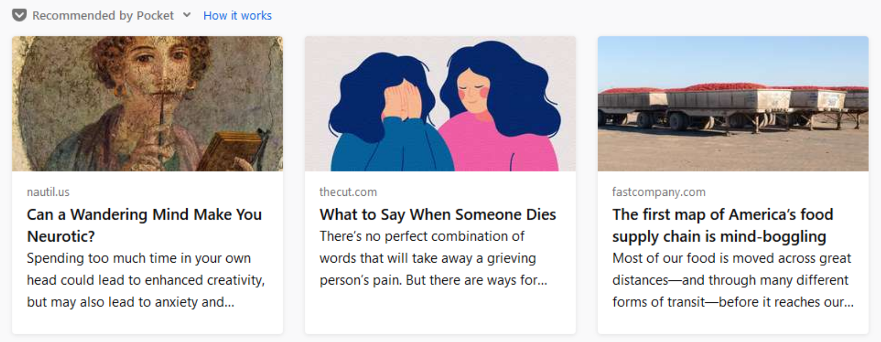
Recommendations
Suggesting popular notes or similar content consumed by users
Pocket
Pocket

Slide 3
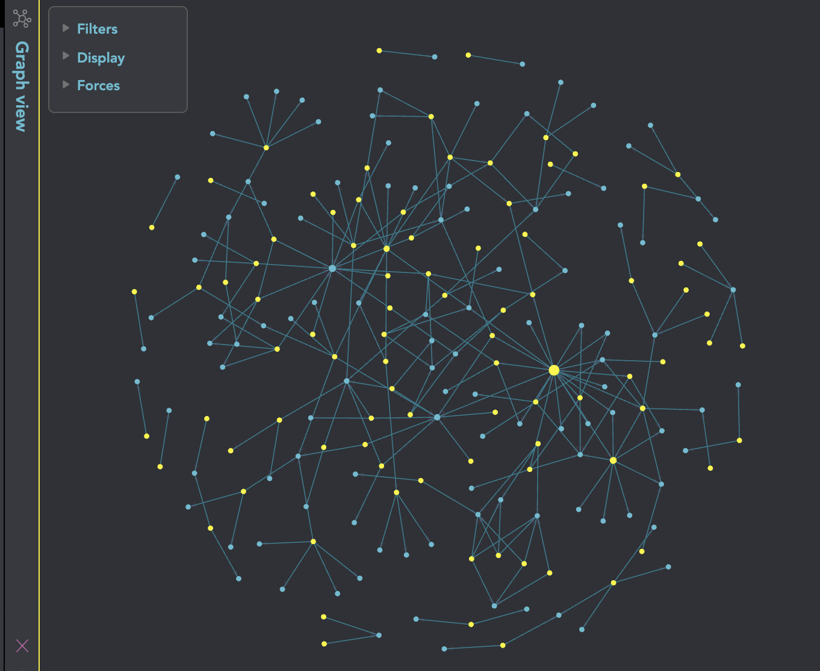


Motivation
How do we store ideas?
15000 notes (Every dot is a note)
15000 notes on paper

Slide 4
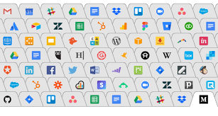


Motivation
Too many tabs
How can we
keep it tidy?
Save in a group

Slide 5
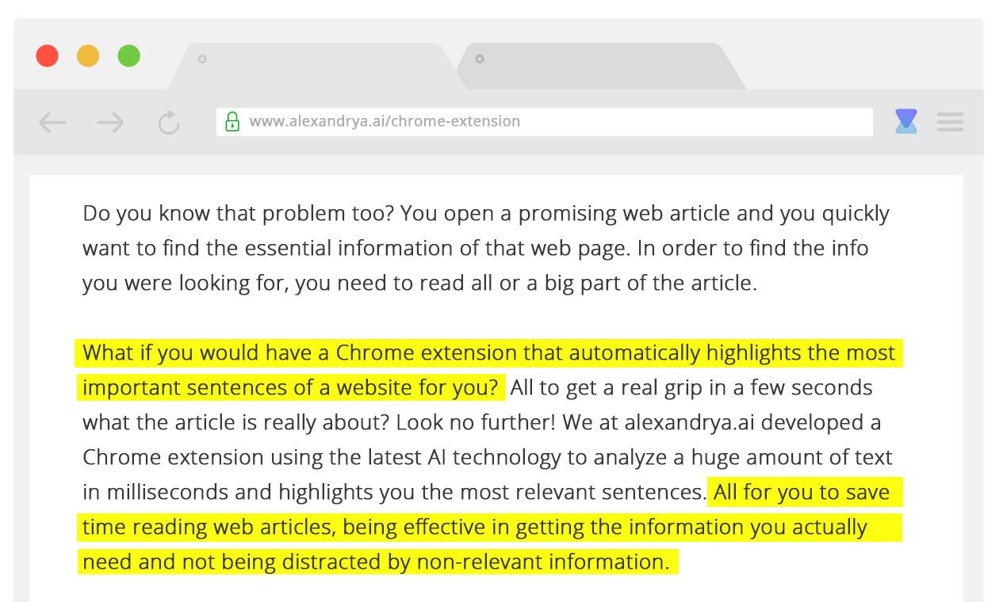

Motivation
Add your
own perspective
in an article!

Slide 6
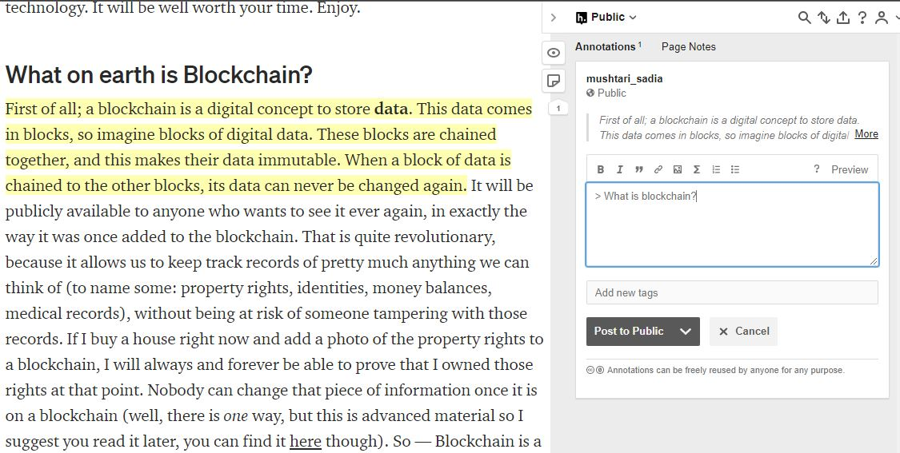

The annotating and highlighting feature of the browser extension
hypothes.is
Highlighting

Slide 7
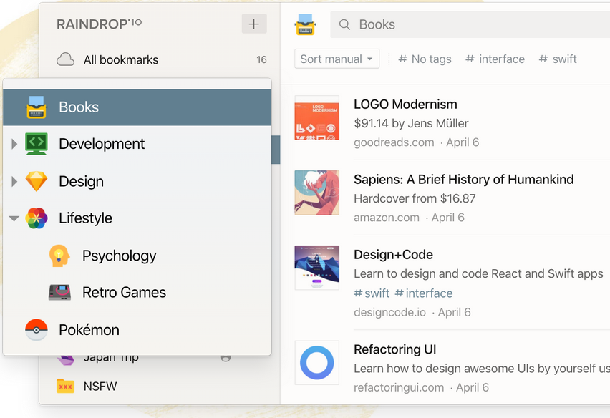

Organize articles in a folder system
Raindrop.io
Categorization

Slide 8
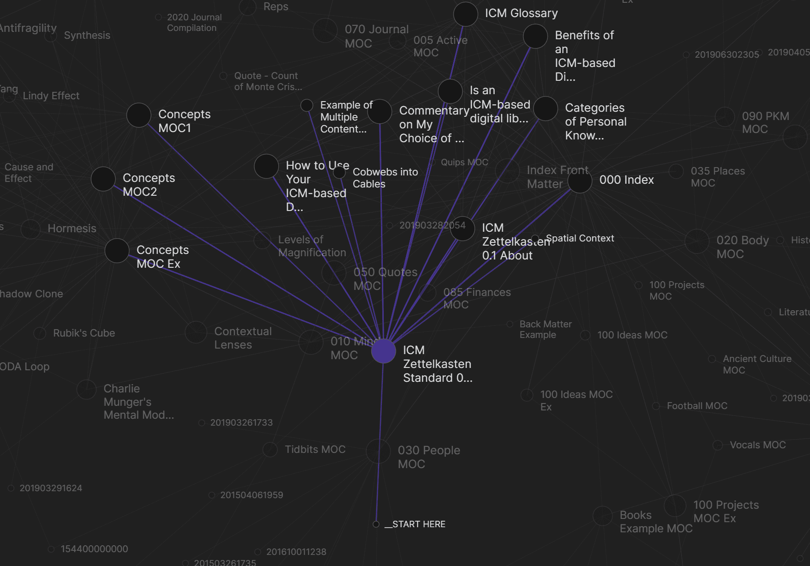

Cross
Reference
Connect related topics
Obsidian

Slide 9
Recommendations
Suggesting popular notes or similar content consumed by users
Pocket
Pocket

Slide 10

Features
Highlighting
Annotating online articles real-time
from browser extension and add supplementary notes.

Slide 11

Features
Rich note taking
Notes displayed in our website for further modifications with markdown & media support

Slide 12
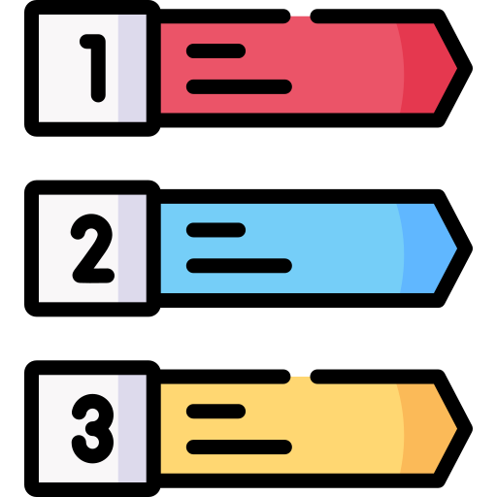
Features
Categorization
Arrange in hierarchy using tags and folder hierarchy to get what they want

Slide 13

Features
Cross reference
Form connections in a graph to gain new insights from disparate notes

Slide 14

Notes
  Markdown Support
  Storage
  Web application
  Sharing publicly
Highlights
  Browser Extension
  Storage
Modules
Categorization
  Tags
  Folder hierarchy
  Cross Reference
Recommendation
  Topic Suggestions
  Note Suggestions

Slide 15
Distribution of Upcoming Presentations
 | Presentations | Student ID | Name
 | Scope fixation | 1705038, 1705039 | Fardin Hossain Oyon, Tahmeed Tarek
1 | Requirements analysis using BPMN diagram | 1705037 | Mushtari Sadia
2 | Mock UI | 1705039 | Tahmeed Tarek
3 | Class diagram + ER diagram in applicable cases | 1705036, 1705044 | Ayan Antik Khan, Najibul Haque Sarker
4 | Interaction diagram + State diagram in applicable cases | 1705032, 1705038 | Tanjim Ahmed Khan, Fardin Hossain

